Slide 1

URBAN MOBILITY CHALLENGE

Slide 2
Outline
Introduction & Objectives
Framework
Trajectory tracking
Via state error feedback control
Via output error feedback control
Parking
Cartesian regulation
Posture regulation

Slide 3
Introduction: the "urban mobility challenge"
Problem: An autonomous guided vehicle (AGV) has to travel along a closed circuit avoiding the other AGVs that are parked along the path; at the completion of one lap, the AGV has to get off the circuit and park at the box
PROJECT OBJECTIVES:
Track a closed-loop trajectory
Avoid obstacles on the trajectory
After performing one lap, reach an empty parking lot
PROPOSED SOLUTIONS:
State / output error feedback
Online sensor implementation
Cartesian / Posture regulation

Slide 4
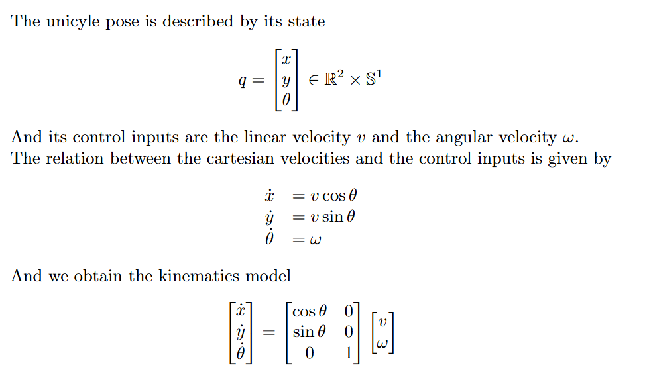
Framework: unicycle
θ
y
x

Slide 5
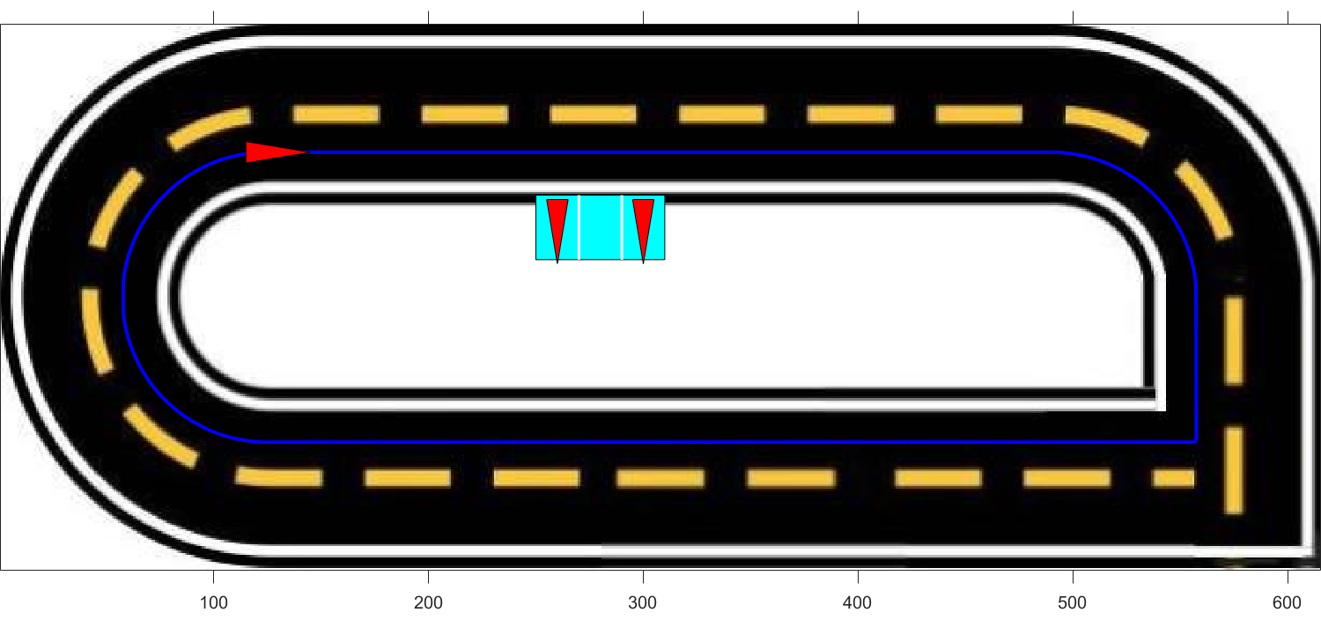
Framework: trajectory
To design the desired trajectory, a series of waypoints was defined. These waypoints were then interpolated using cubic spline interpolation to ensure a continuous path
To test controllers' functionalities on a non-continuous path, a sharp square-angle turn is added to the path

Slide 6
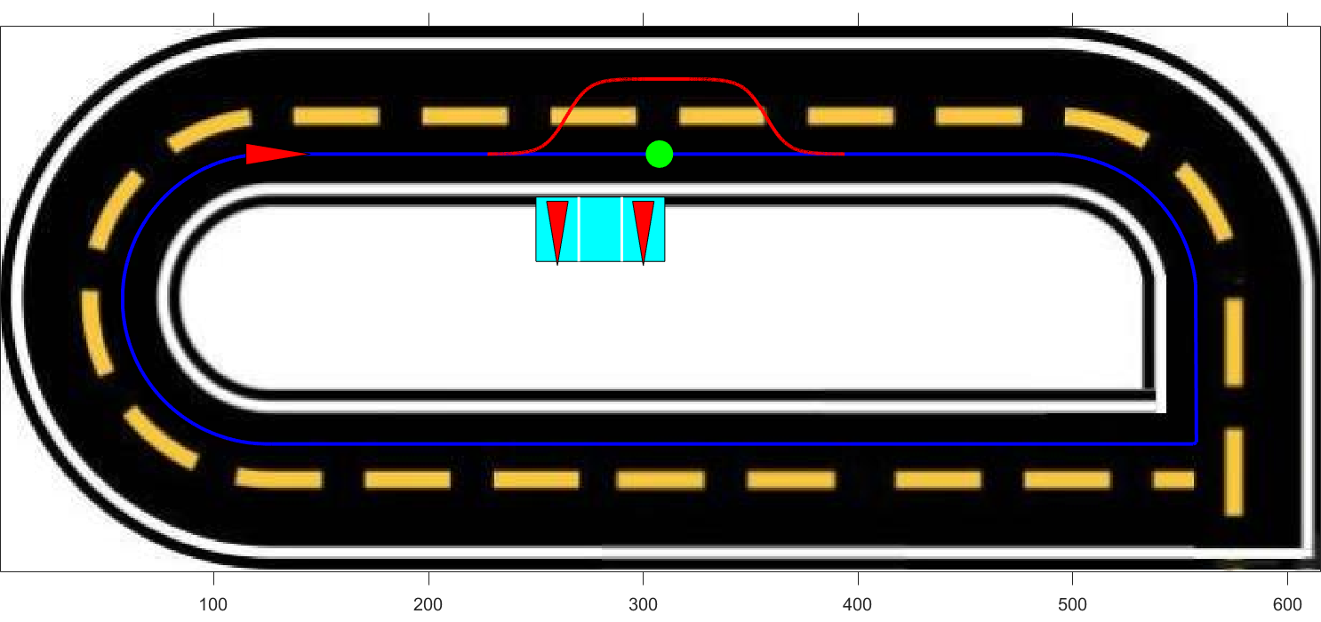
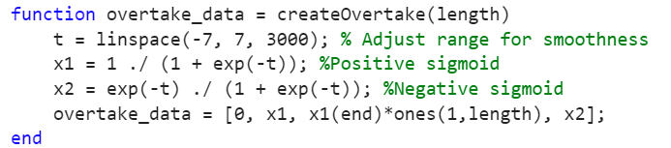
Obstacle avoidance
The unicyle after detecting the obstacle progressively reaches the second lane, after overtaking the obstacle it progressively returns to the first lane
To ensure a smooth and continuous trajectory during the changing lane procedure a sigmoid function has been used

Slide 7
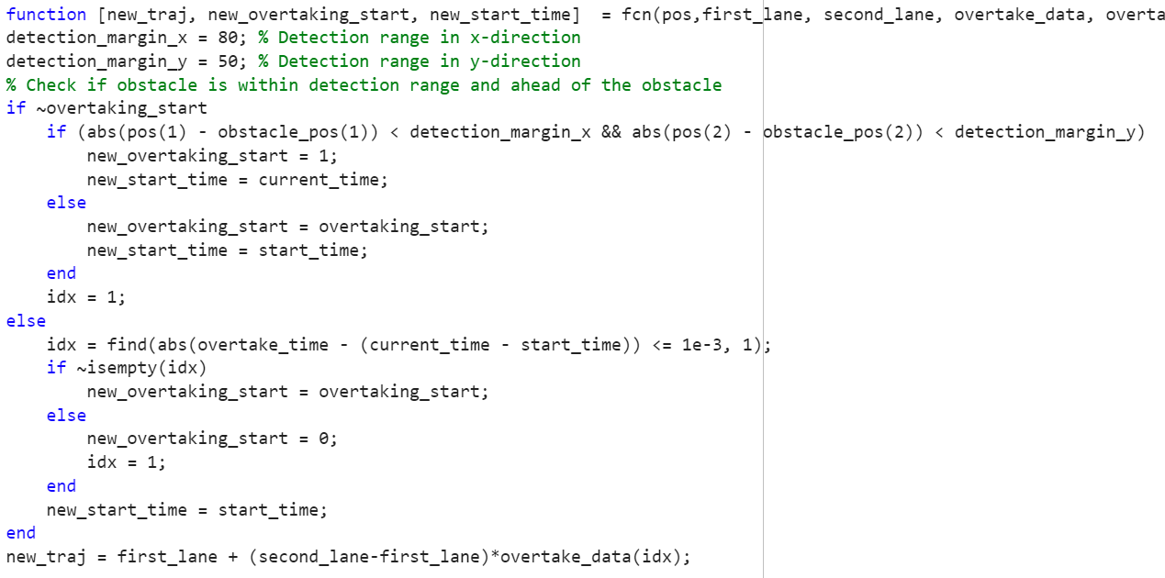
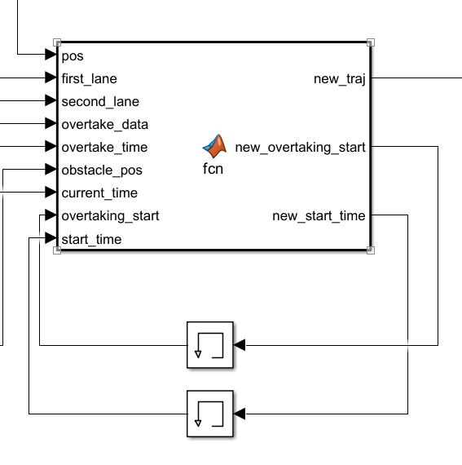
Obstacle avoidance

Slide 8
TRAJECTORY TRACKING - STATE ERROR FEEDBACK

Slide 9
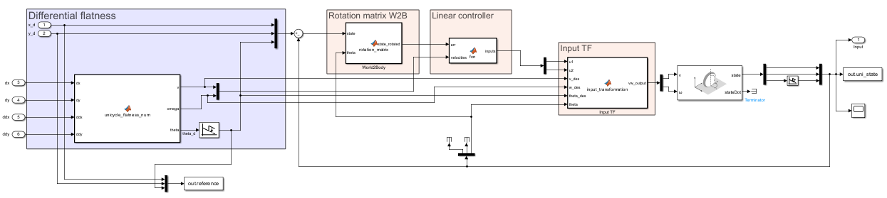
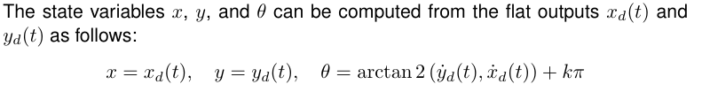
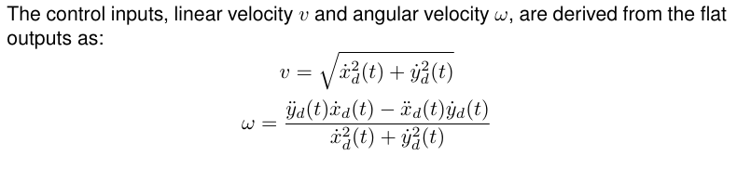
Linear Control
Notes:
THINGS TO SAY:
General overview of the structure
Say that Sigma linear asymp stable → we can only conclude that Sigma NL loc AS
Vdes != 0 , so persistent trajectory (even more important later on with k2 (v is at the denom)
w depends on v^2 basically, so we must have v !=0, furthermore later on , k2=num/vd so vd!=0 otherwise k2 explodes, we will add a saturation on it
explain the wrap / unwrap:
we used the unwrap to normalize theta angle, so we don't have the discontinuity going from 2pi to 0

Slide 10
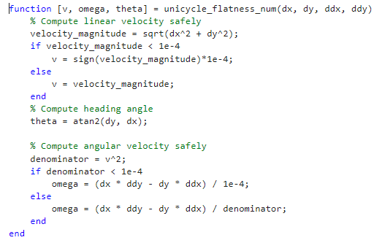
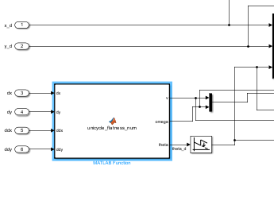
Avoiding division by zero
differential flatness block

Slide 11
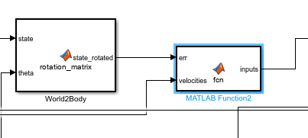
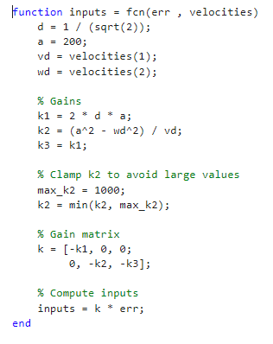
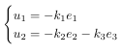
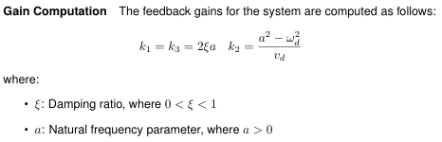
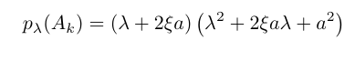
Controller design
Notes:
K1=k3 TI , k2 TV
linear controller so based on Eigs allocation
We can not guarantee asymp convergence cause K2 (system) TV, but we do have convergence property cause we are doing rectilinear and semicircular motions so someway we are covered by good convergence properties
Say something about eigenvalues, thanks to this ki we know the eigs are on the LHS

Slide 12
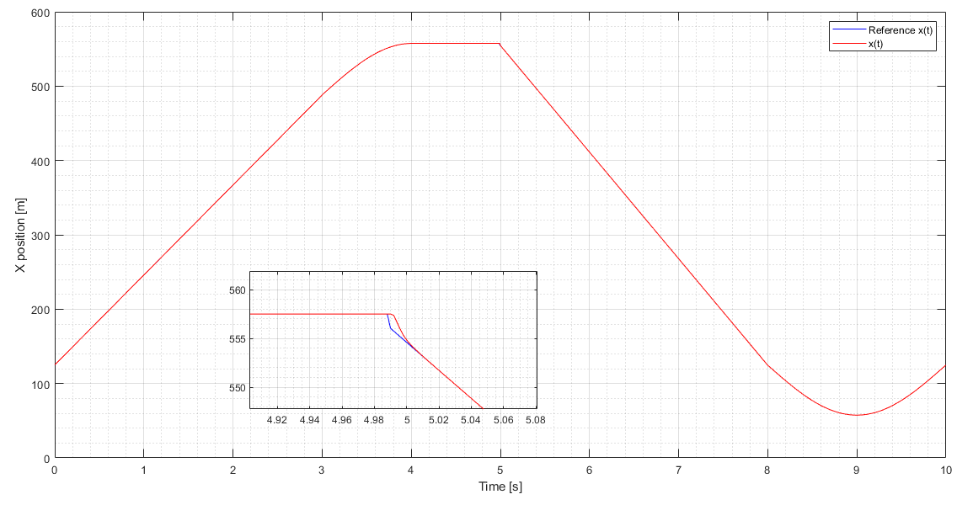
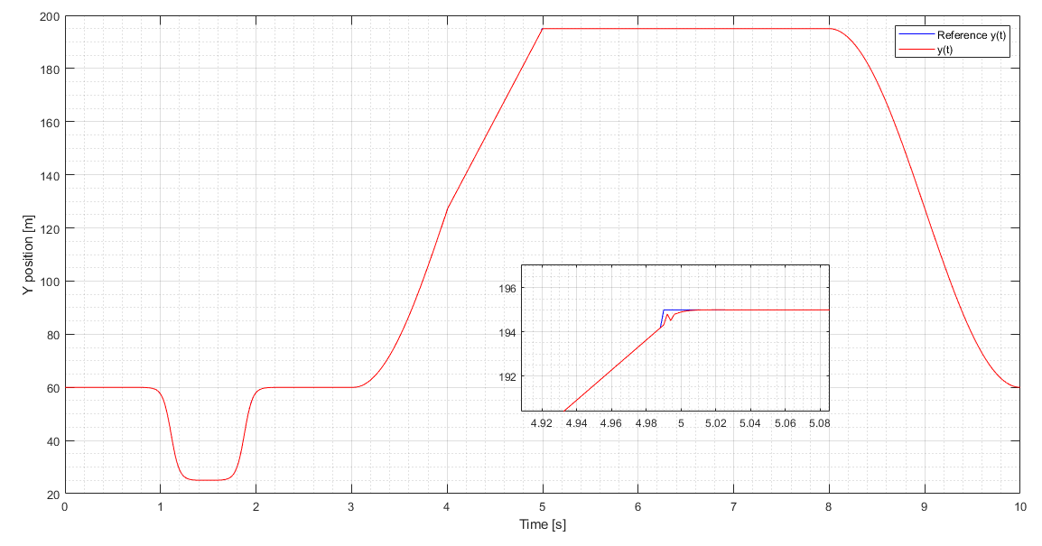
X TRACKING
Y TRACKING

Slide 13
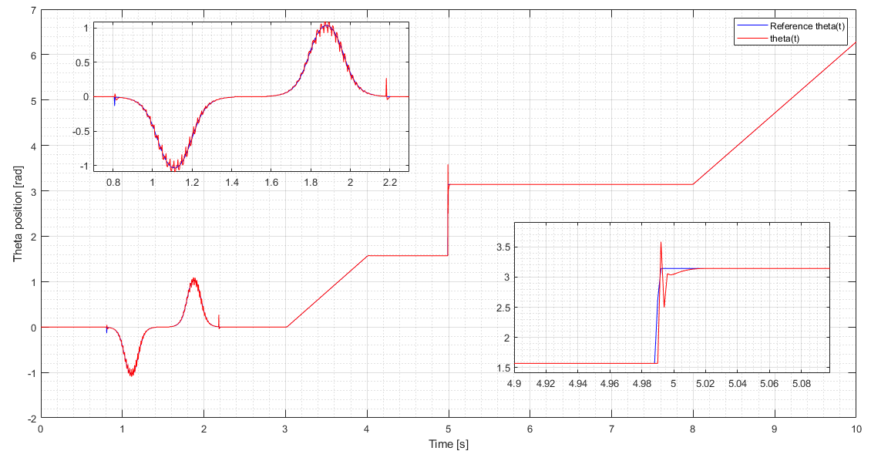

Slide 14
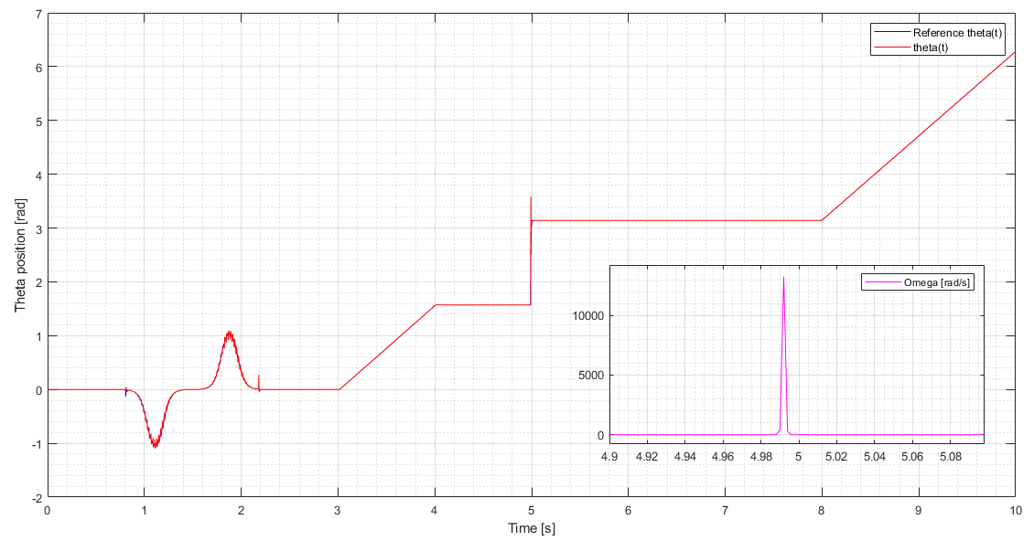
FOCUS ON SQUARE CORNER
Notes:
differential flatness block should not be able to compute the input velocities when reaching a non differentiable part of the trajectory. Indeed, impulses in both velocities arises, with stronger effect in omega, (its computation is based on the second order derivative).
Nonetheless, thanks to saturator blocks on omega and gains we are able to overcome the problem and to finish the simulation anyway.

Slide 15
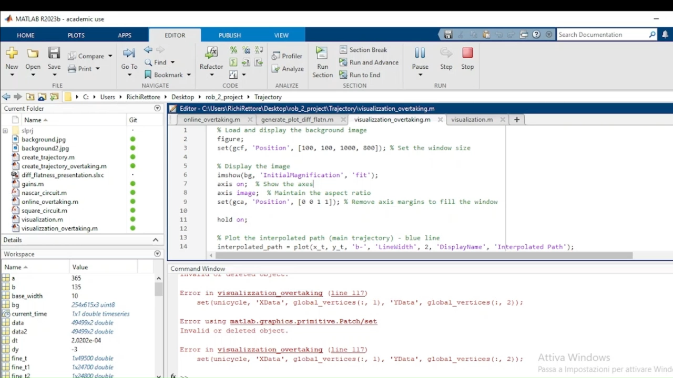

Slide 16
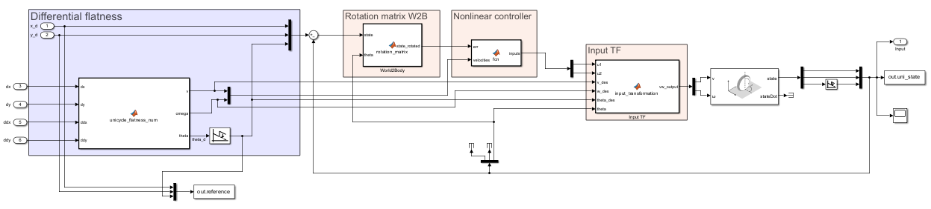
Non Linear Control
Notes:
THINGS TO SAY:
General overview of the structure and vdes!=0 → same as before cause its related with diff flatness
Highlights the same nature of the structure, with the only difference : gain computation and feedback law
Controller based on Lyap arguments and not eigs allocation
Barbalat’s lemma problem. Before we had no convergence guarantees cause k2 TV , now instead we could end up with loosing conv property cause w could become unbounded and hence Barb no true anymore -→ this is what we stress out in the sharp curve
explain the wrap / unwrap:
we used the unwrap to normalize theta angle, so we don't have the discontinuity going from 2pi to 0

Slide 17
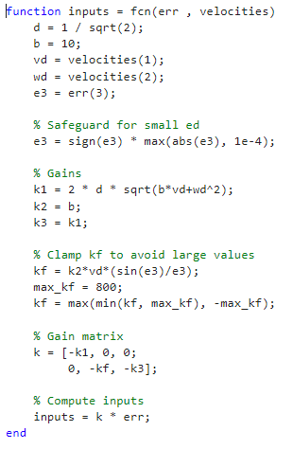
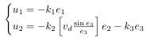
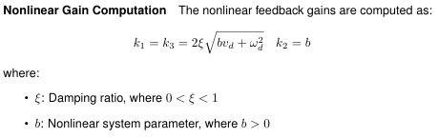
Controller design
Notes:
k1=k3 TV , k2 TI
Highlight the relation between a and b , could we also compute eigs for this ? Is b a natural freq too ?

Slide 18
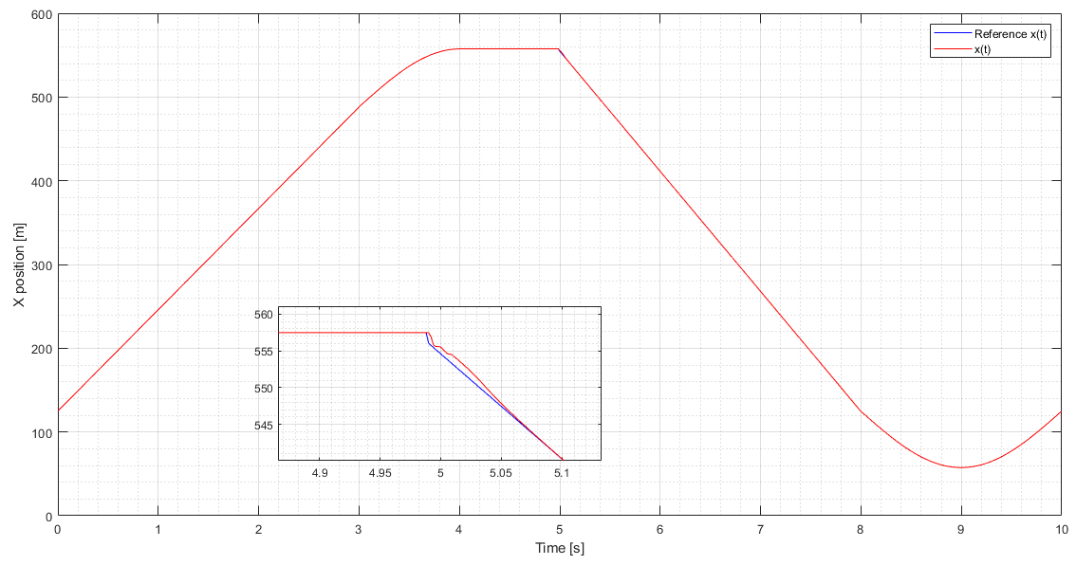
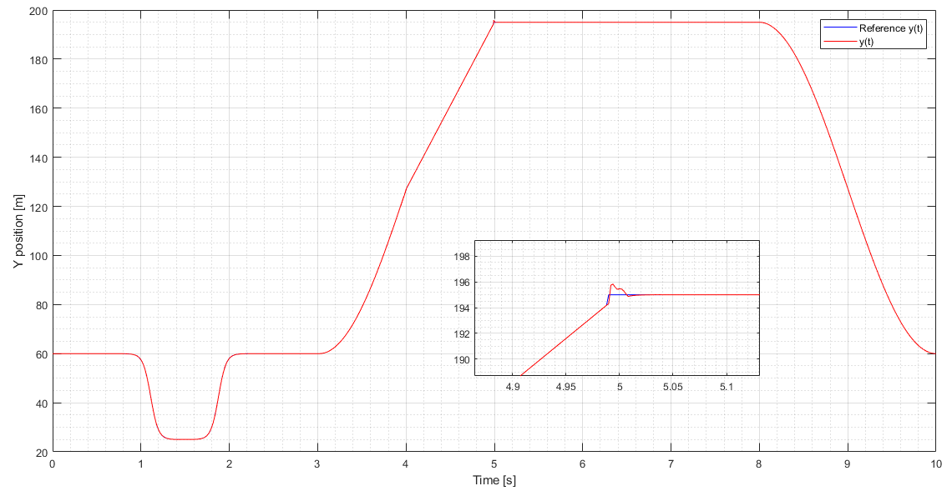
X TRACKING
Y TRACKING

Slide 19
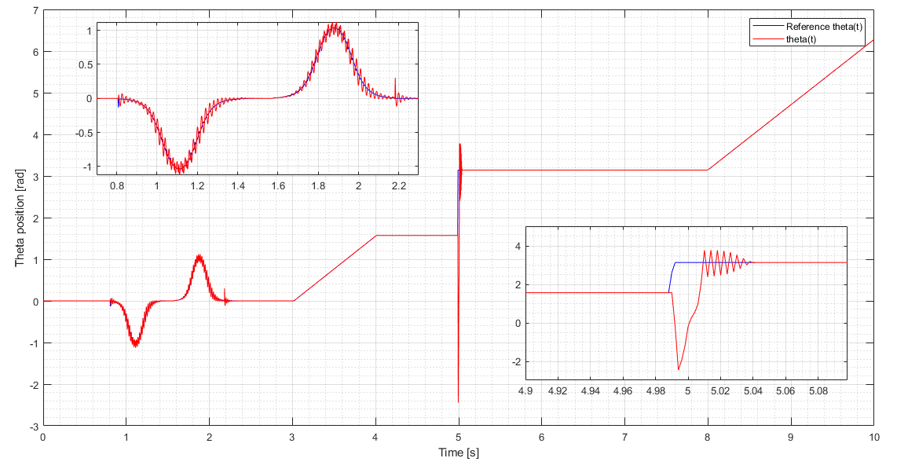
Notes:
Plots --> see if impulse bigger than linear case follows some theoretical thing or just related to gains tuning

Slide 20
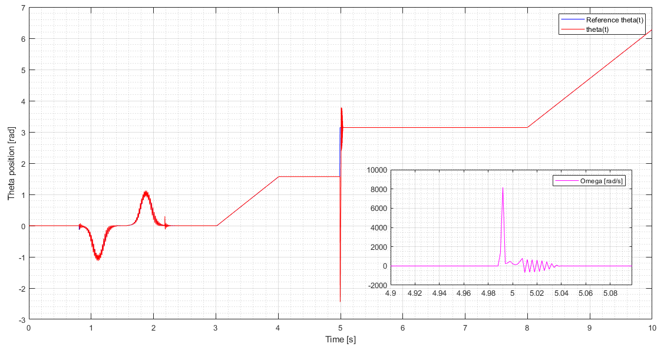
FOCUS ON SQUARE CORNER
Notes:
Focus on sharp curve
Make a consideration regarding NL more enhanced wrt lineare case, maybe theres a reason

Slide 21
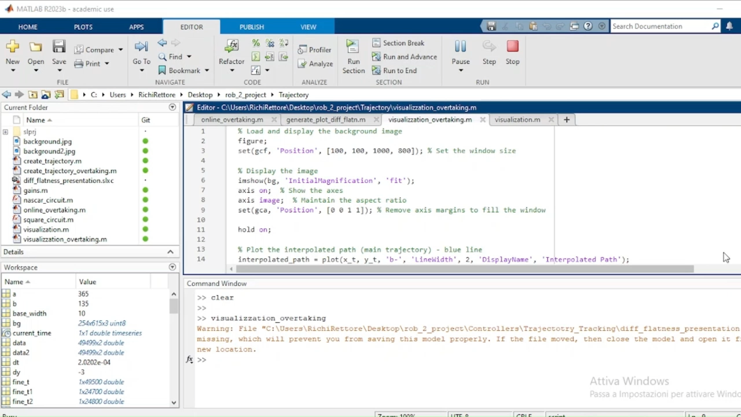

Slide 22
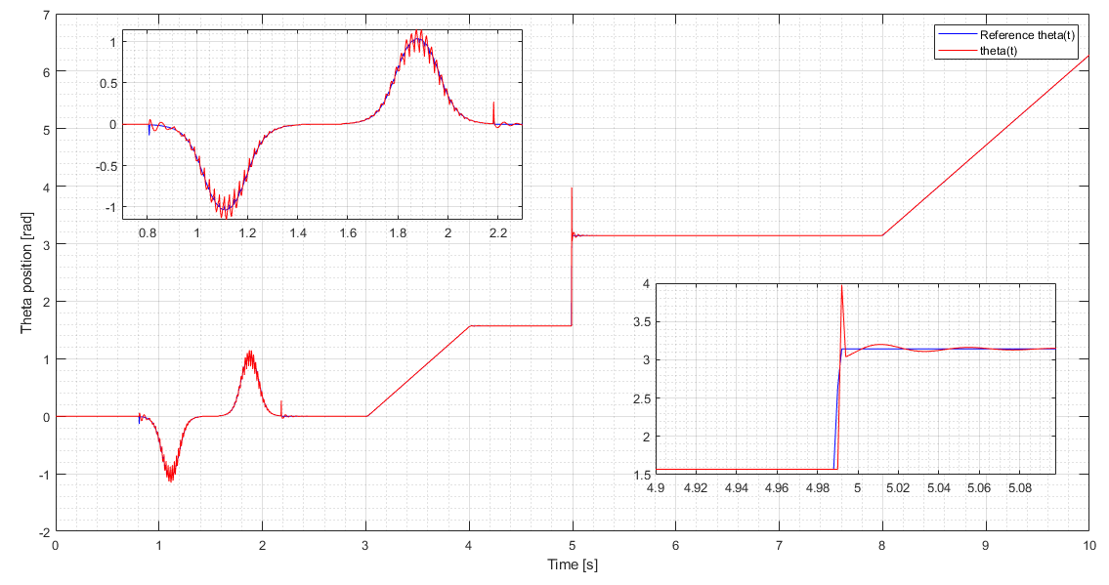
d = 2 / sqrt(2)
b =1
Notes:
So less aggressive, less reactive , more stable

Slide 23
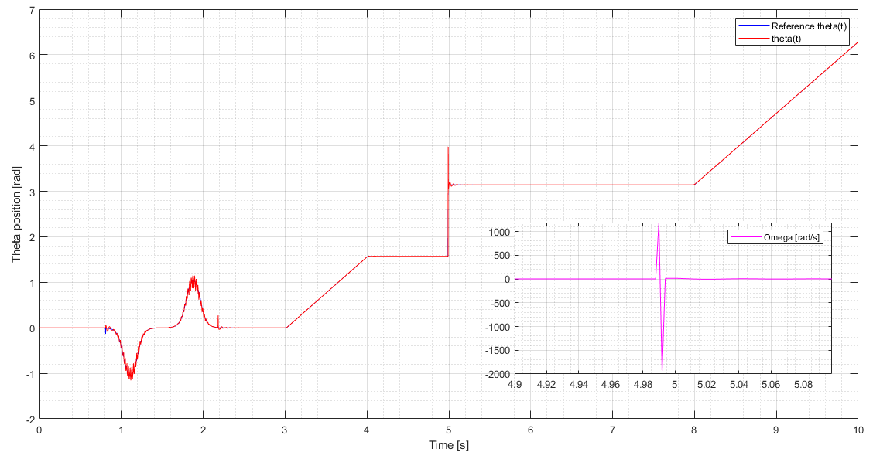
d = 2 / sqrt(2)
b =1

Slide 24
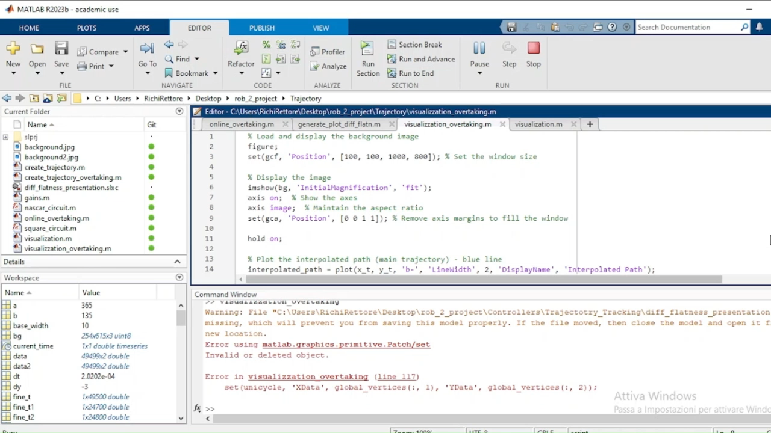

Slide 25
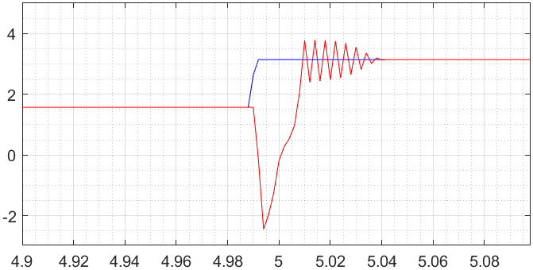
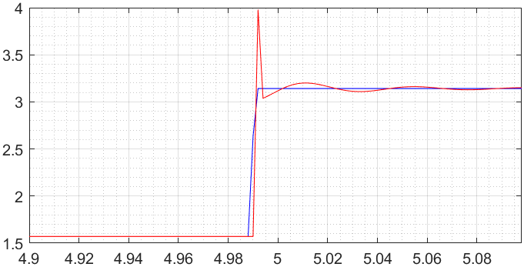
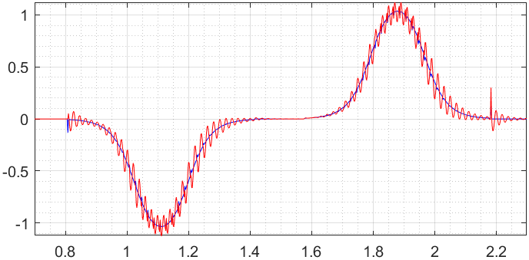
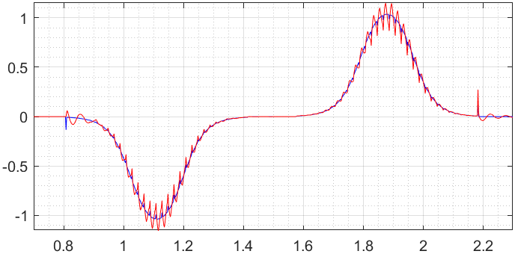
d = 1 / sqrt(2)
b =10
d = 2 / sqrt(2)
b =1
d = 1 / sqrt(2)
b =10
d = 2 / sqrt(2)
b =1
Notes:
Left: More aggressive , more reactive
Right: less aggressive , less reactive but more stable

Slide 26
Qualche breve considerazione finale sui due controllori, che poi verrà ripresa meglio alla fine della presentazione

Slide 27
TRAJECTORY TRACKING - OUTPUT ERROR FEEDBACK

Slide 28
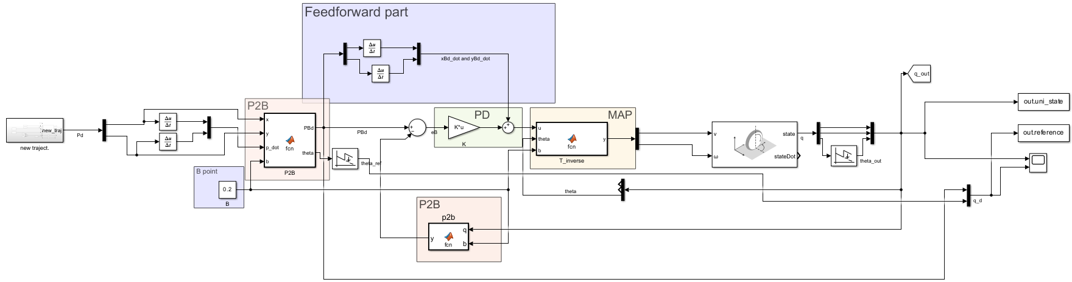
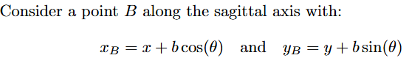
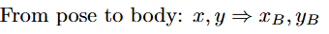
Feedback linearization based on a reference point on the sagittal axis

Slide 29
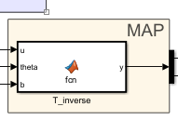
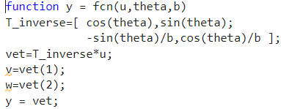
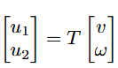
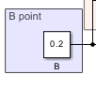
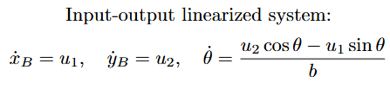
Map
Notes:
B need to be different from 0

Slide 30
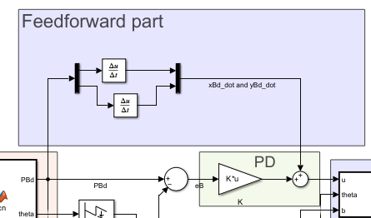
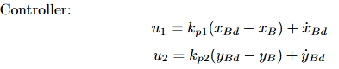
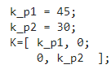
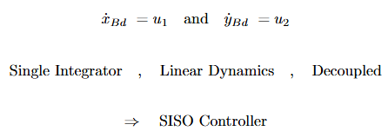
Controller design
Pro:

Slide 31
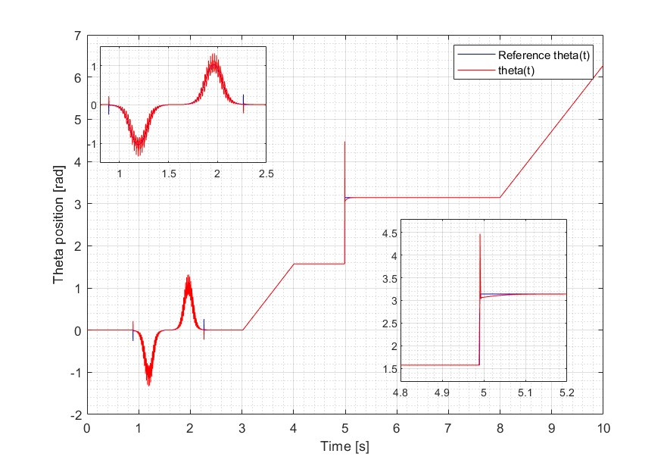

Plot
Notes:
As expected no problem with square corner if b different from 0. Overshoot due to a control in coordinate with respect the b point and not in coordinate x,y

Slide 32


Notes:
As expected no problem with square corner if b different from 0.

Slide 33

Plot
Notes:
Different B: too close to 0 (0.1) we obtain the worst theta as expected. Also with large B (10) we have error (more in y) (capire il perché)

Slide 34

Notes:
Different B: too close to 0 (0.1) we obtain the worst theta as expected. Also with large B (10) we have error (more in y) (capire il perché)

Slide 35



Feedback linearization based on second order derivatives

Slide 36




Map
Notes:
Since we are dealing with second-order dynamics (acceleration), we need to use an integrator. This introduces some requirements on the trajectory.
It is possible to compute the square corner if we place a check on ω (since its value depends on two components that have v as the denominator). Otherwise, it will explode to infinity.

Slide 37




Controller design
Need:

Slide 38

Plot

Slide 39


Plot
Notes:
The second-order dynamics have some issues with overtaking, as it is not very smooth. There is also a problem with square corners.

Slide 40


Slide 41
REGULATION
Notes:
We use the first (Cartesian) regulation and the pose without the singularity. Additionally, we implemented the first type of pose regulation, but since our circuit does not have singularities, we chose not to present it

Slide 42


Cartesian regulation

Slide 43



Control law

Slide 44


Plot

Slide 45


Slide 46

Pose regulation

Slide 47


State trasformation

Slide 48


Control law

Slide 49

Plots of all controllers together

Slide 50


Slide 51


Slide 52
Final considerations - tracking
State error feedback
Works with state (x,y,theta), so theta directly controlled
Trajectory must be smooth and persistent
Sysyem is coupled
Controller is more complicated, gains are time varying, convergence is more difficult to guarantee
B-point
Theta is not directly controlled, but coupled in the dynamics with x and y
Reference trajectory must be given in terms of xb,yb so no smooth constraint as far as b!=0
Its the best among all the 4 controllers, less restrictions and best performance in tracking.
System becomes decoupled, gains just must be >0
Further derivatives:
Same problem of diff flatn, trajectory must be smooth(differentiable) and v!=0 (oterwise singular mapping) → persistent traj.
Need to compute 2° order derivatives online, so this causes delays in the tracking (see all plots together)
System decoupled, controller quite easy, gains not only >0 but routh conditions

Slide 53
Final considerations - regulation
Cartesian regulation
Theta non controlled
Controller is quite simple, 2 gains controlling respectively v and w , no singularities issues
System is coupled
Posture regulation
Theta is now controlled but indirectly (trough gamma and delta)
Controller is more difficult (3 gains)
Singularity problem in rho=0 → solved by shifting problem in input

Slide 54


